Slide 1


Slide 2


Slide 3
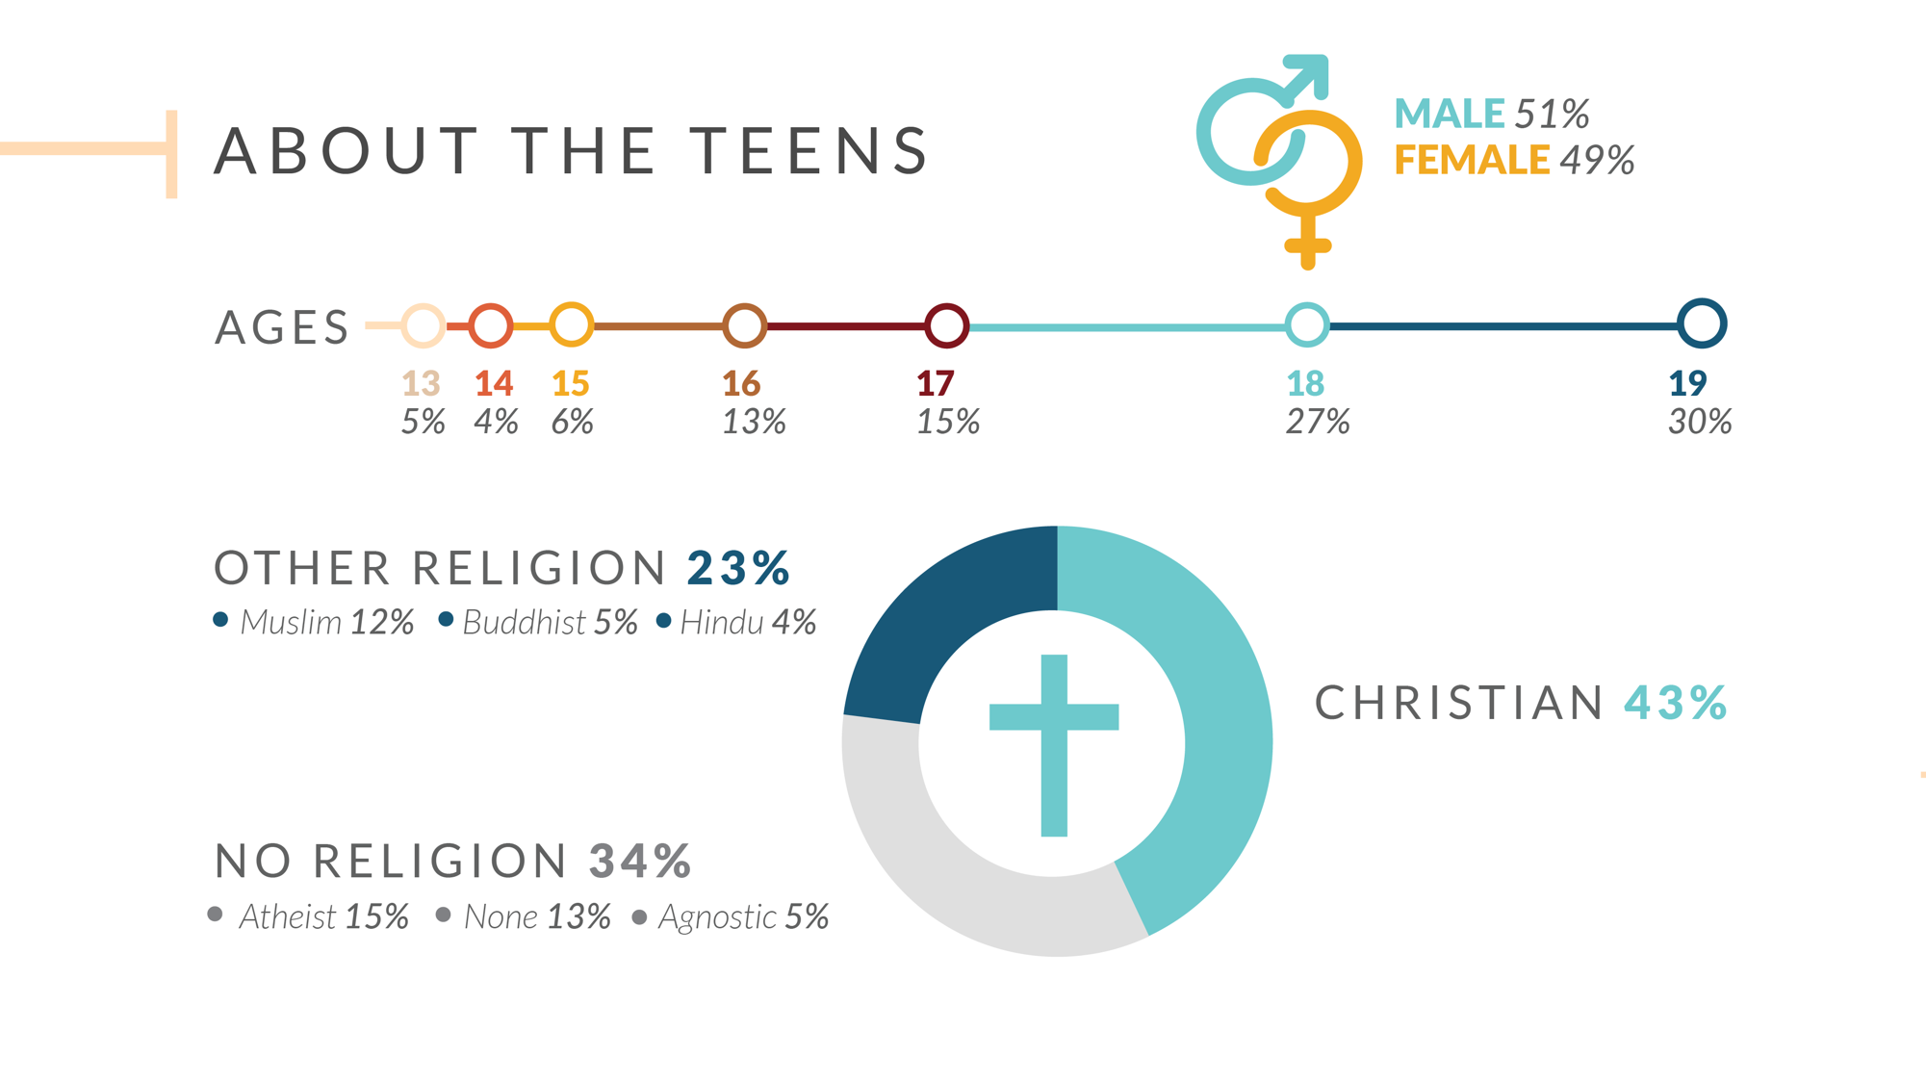

Slide 4


Slide 5


Slide 6
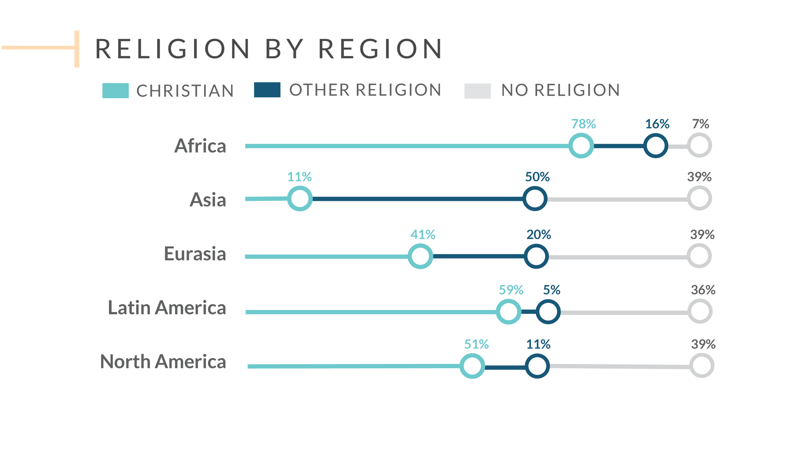

Slide 7


Slide 8
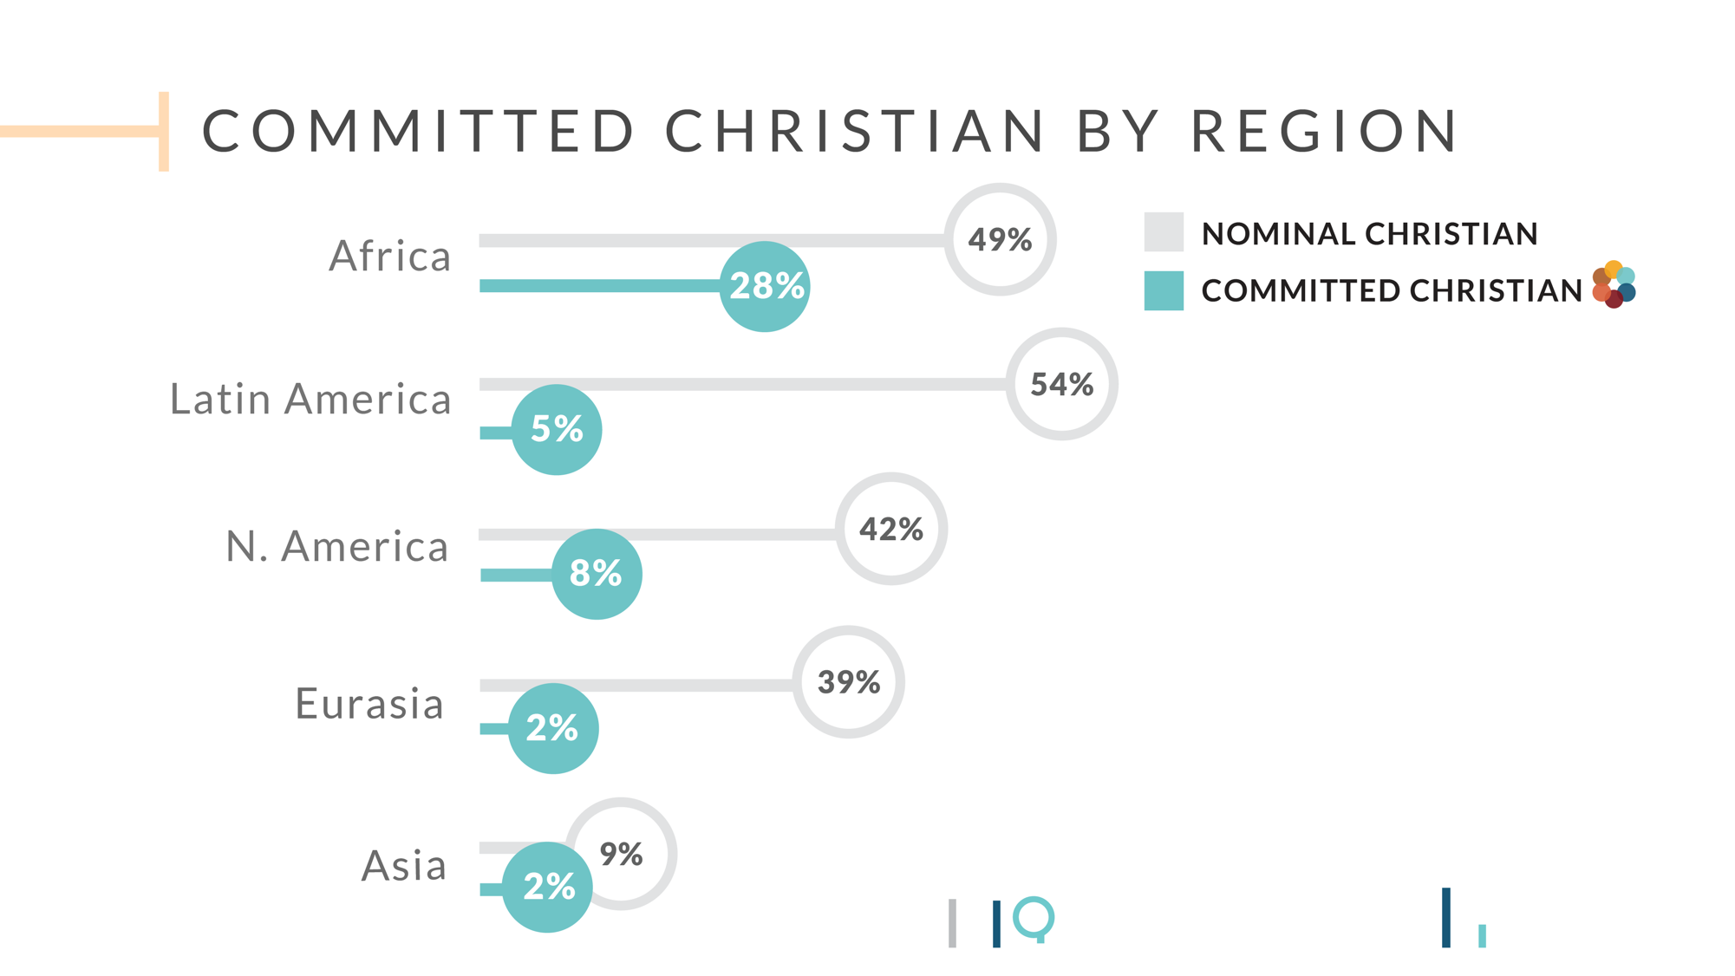

Slide 9


Slide 10
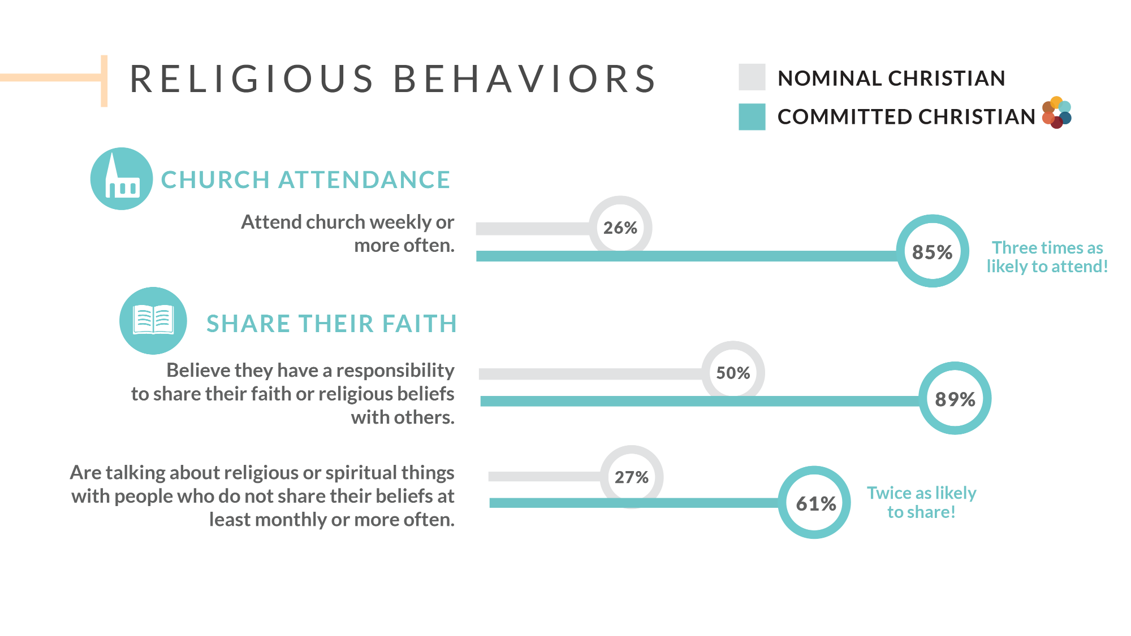

Slide 11


Slide 12


Slide 13


Slide 14
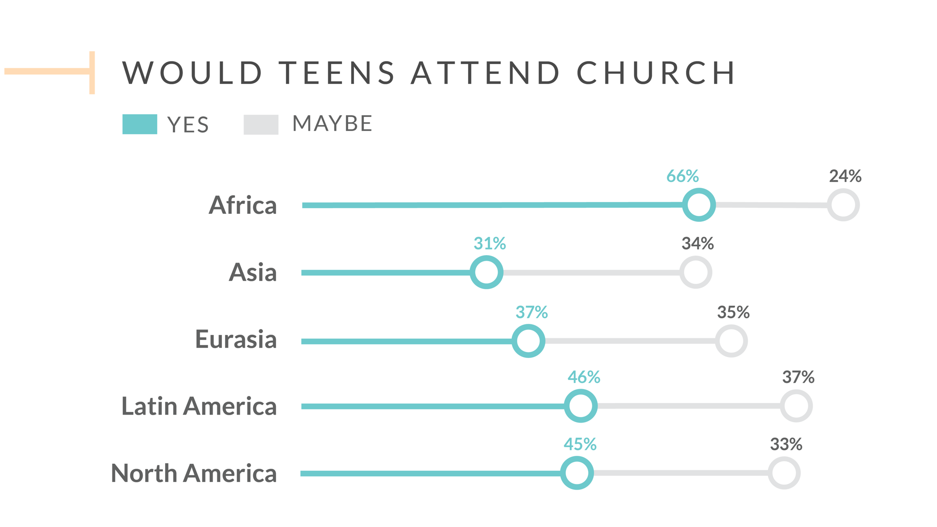

Slide 15


Slide 16


Slide 17
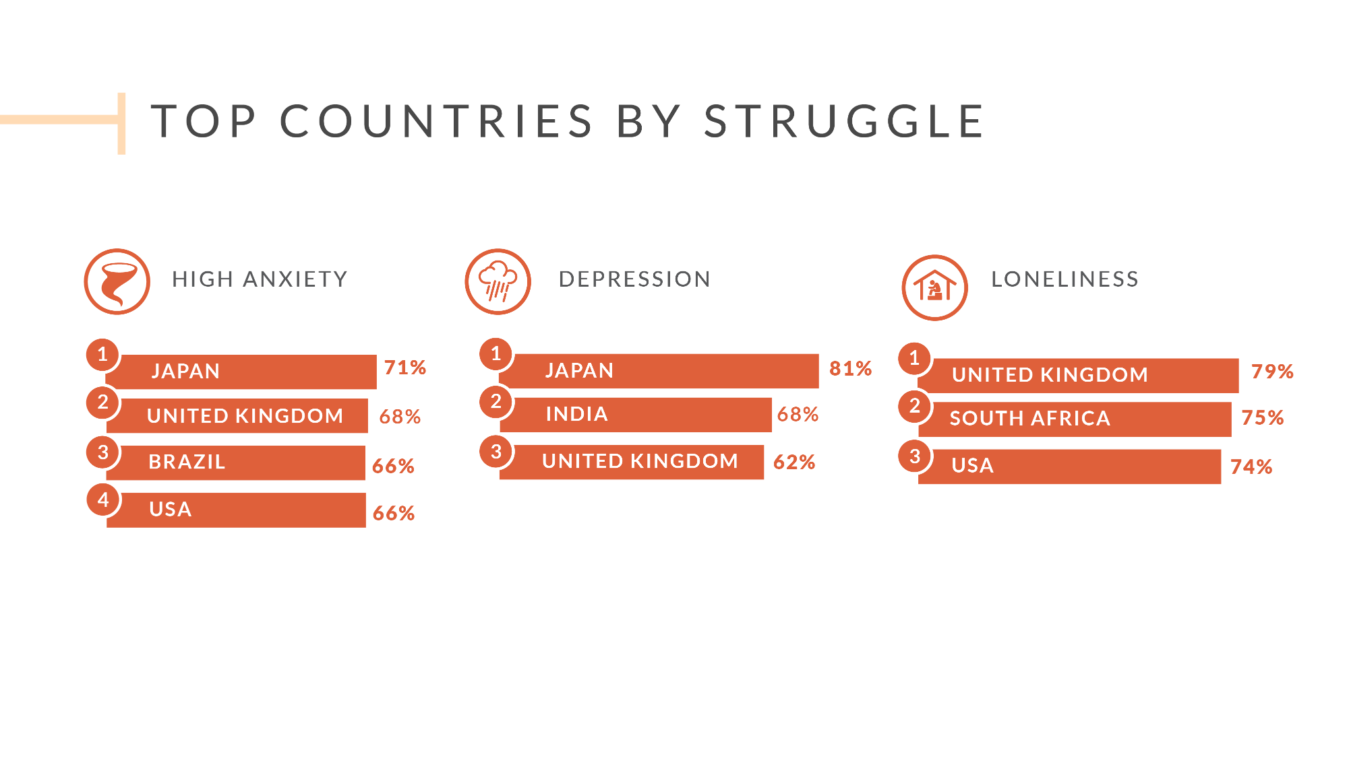

Slide 18


Slide 19


Slide 20


Slide 21


Slide 22
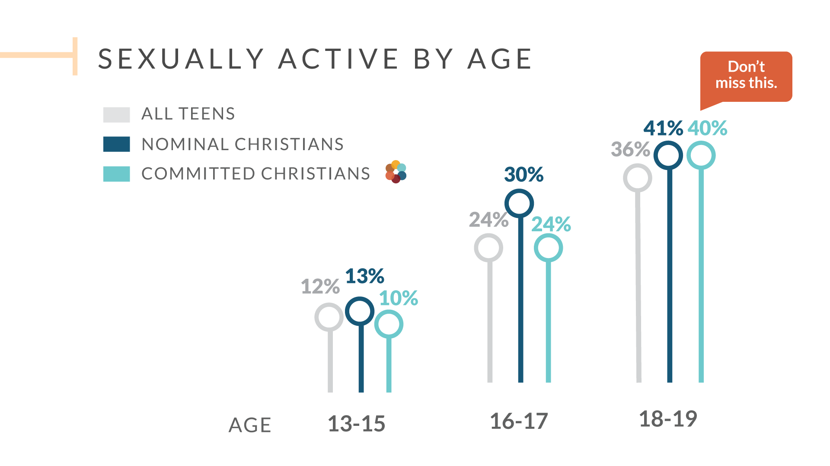

Slide 23
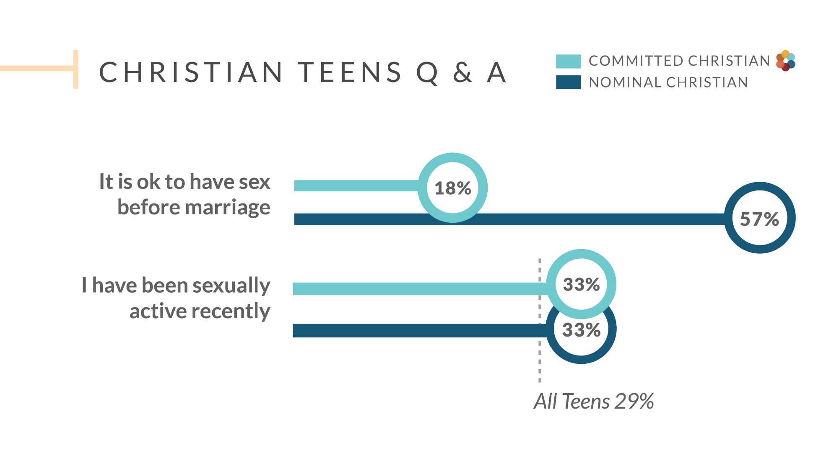

Slide 24
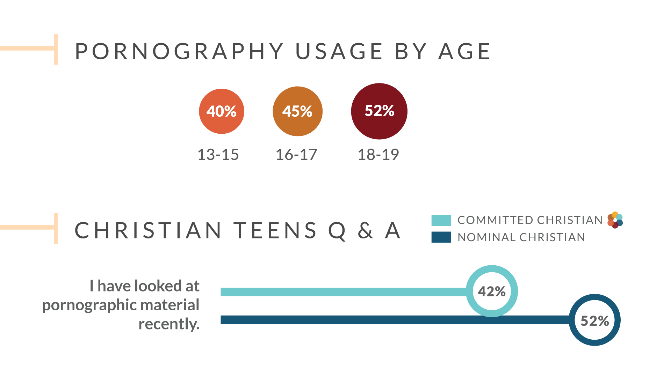

Slide 25


Slide 26


Slide 27
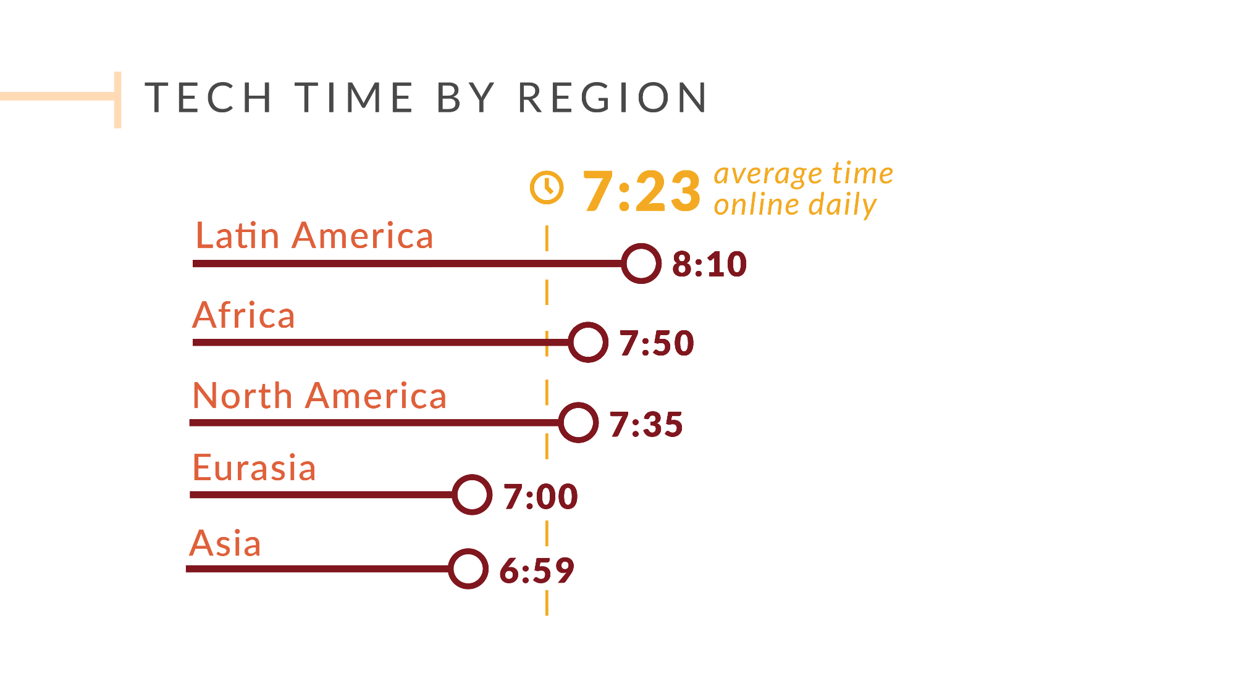

Slide 28
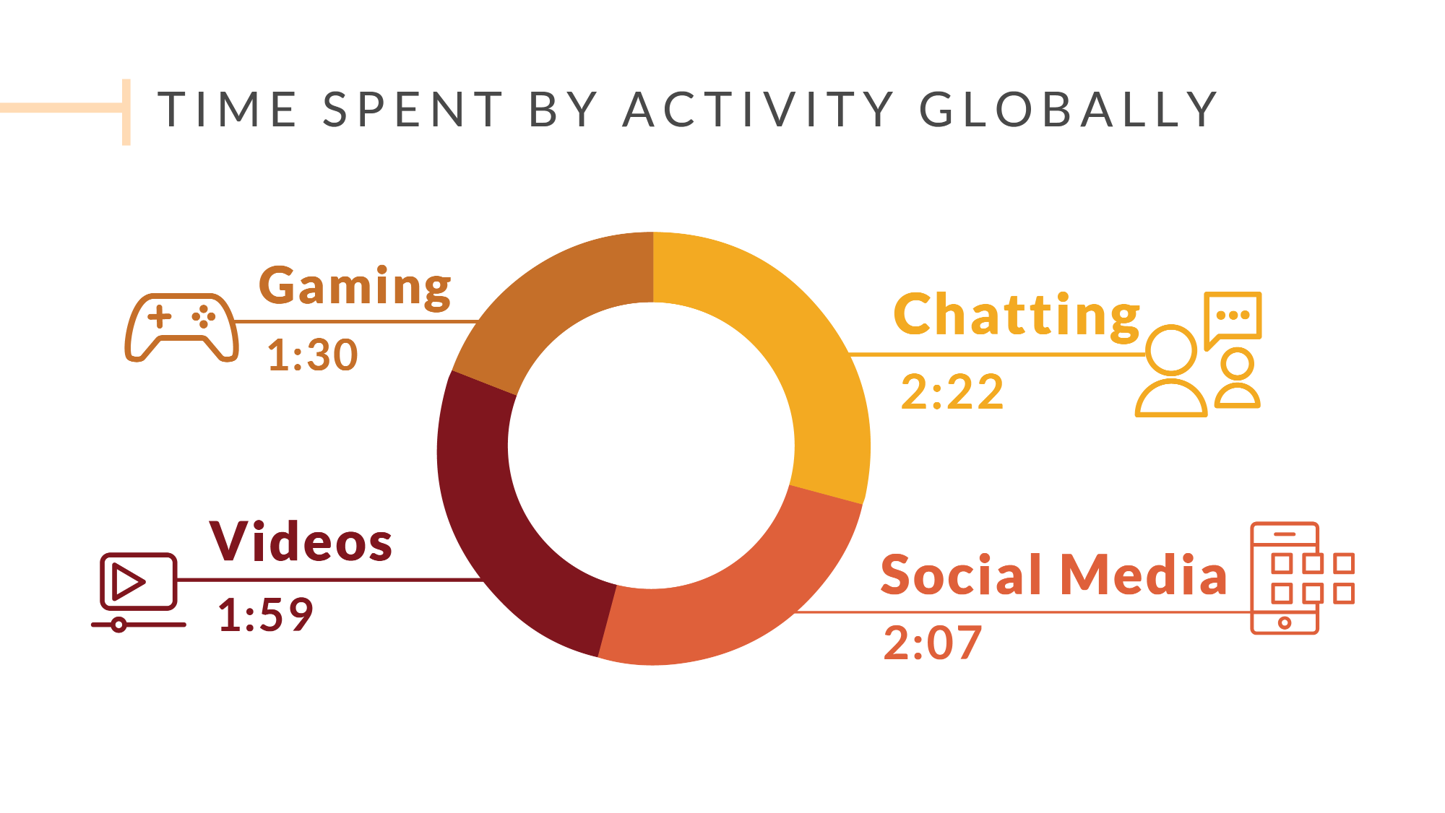

Slide 29


Slide 30
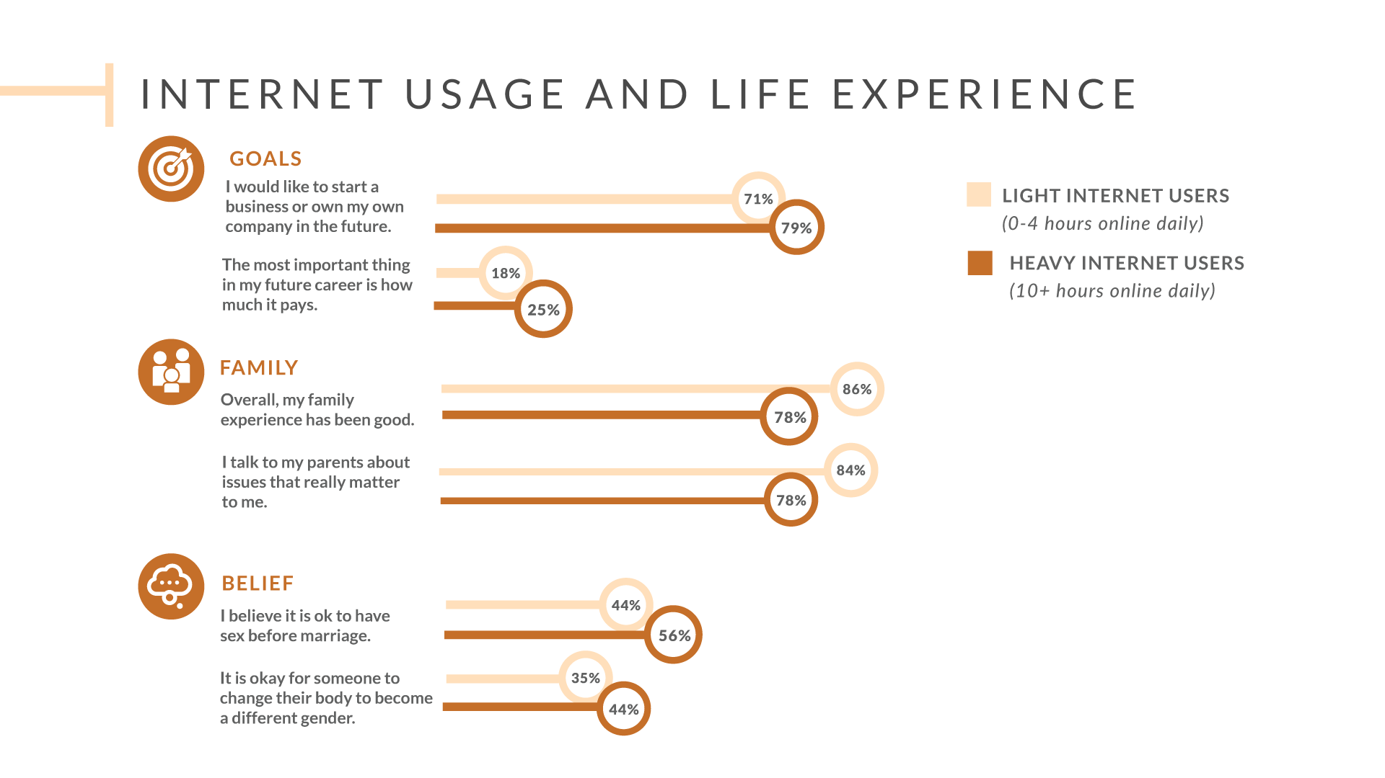

Slide 31
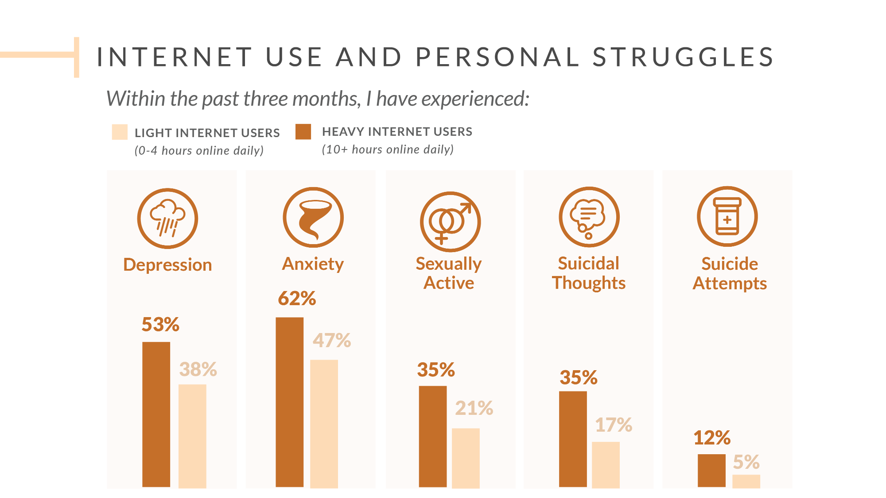

Slide 32


Slide 33


Slide 34
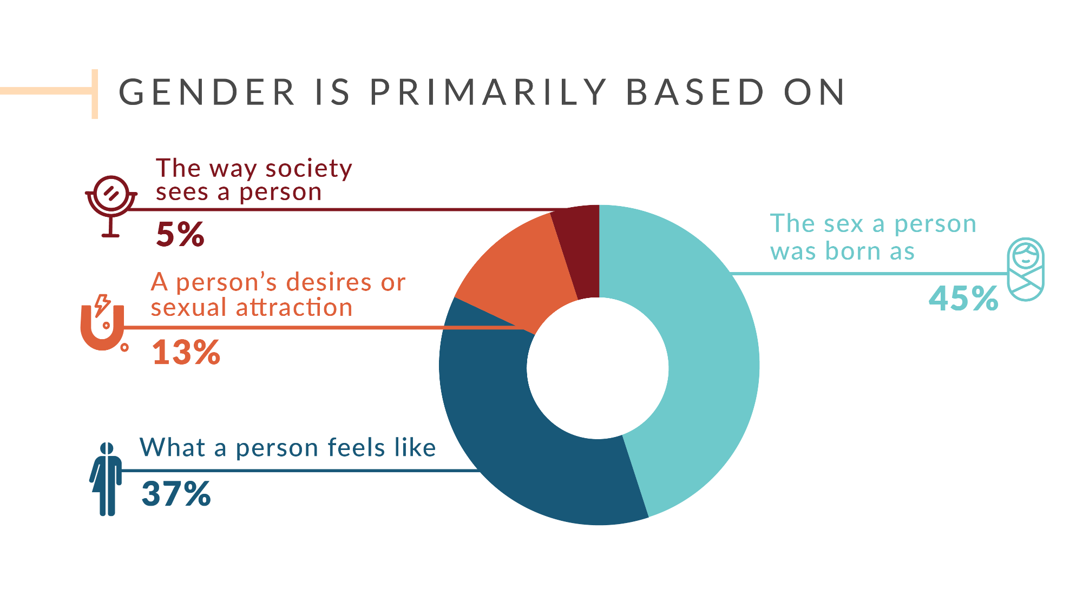

Slide 35
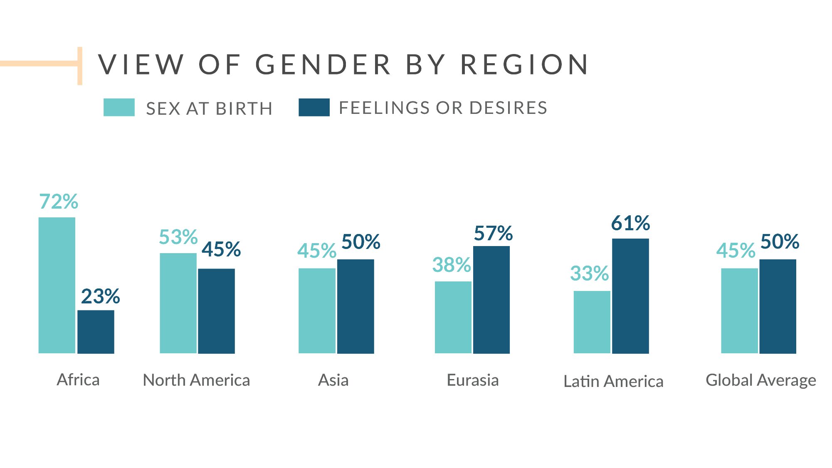

Slide 36
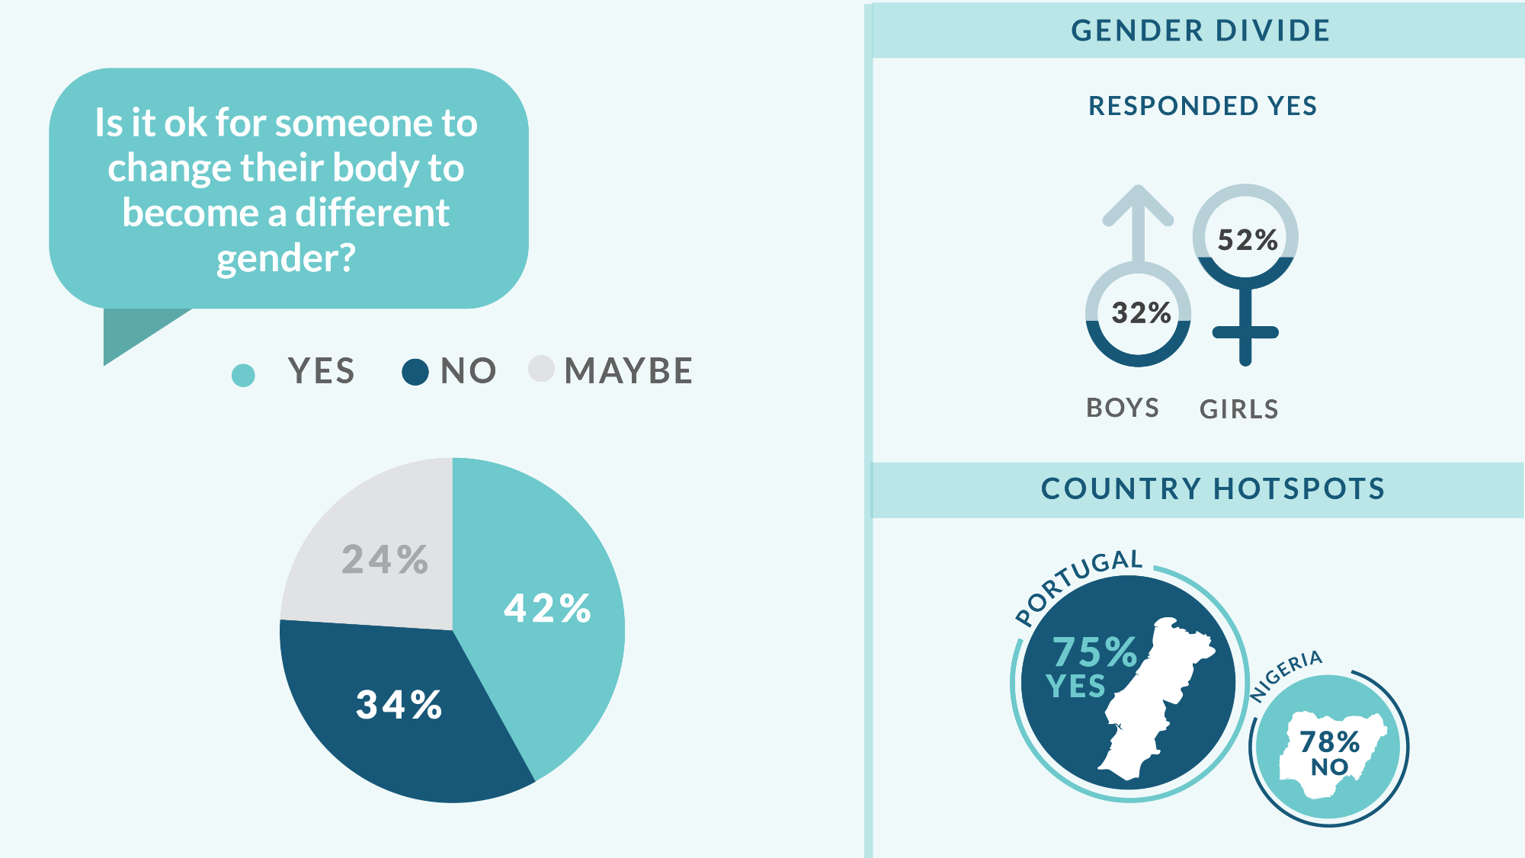

Slide 37
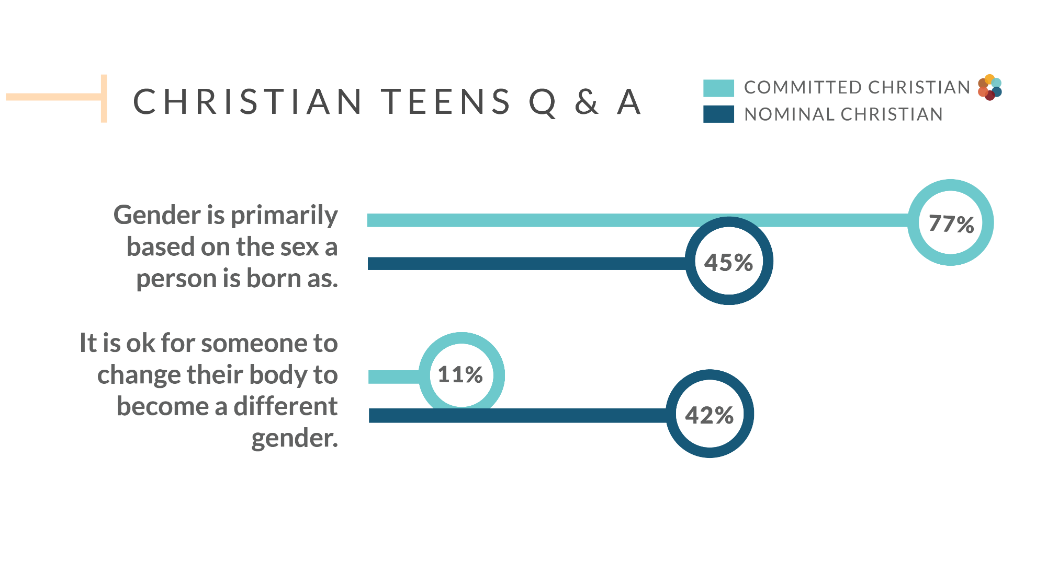

Slide 38


Slide 39
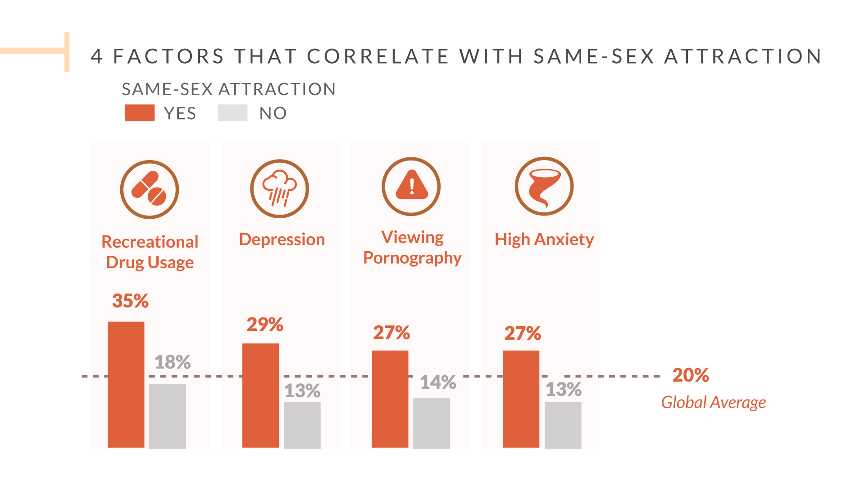

Slide 40
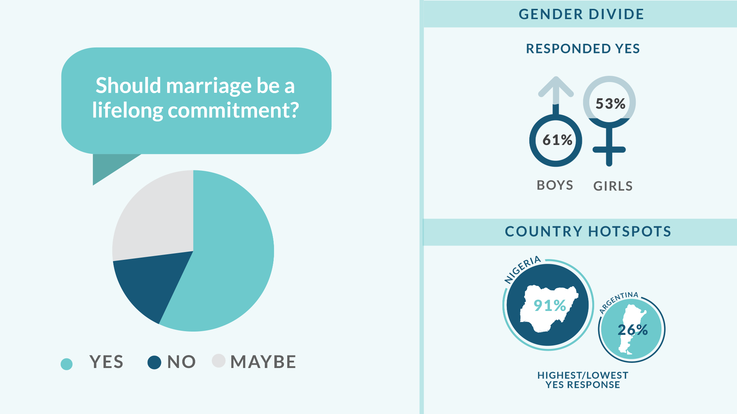

Slide 41
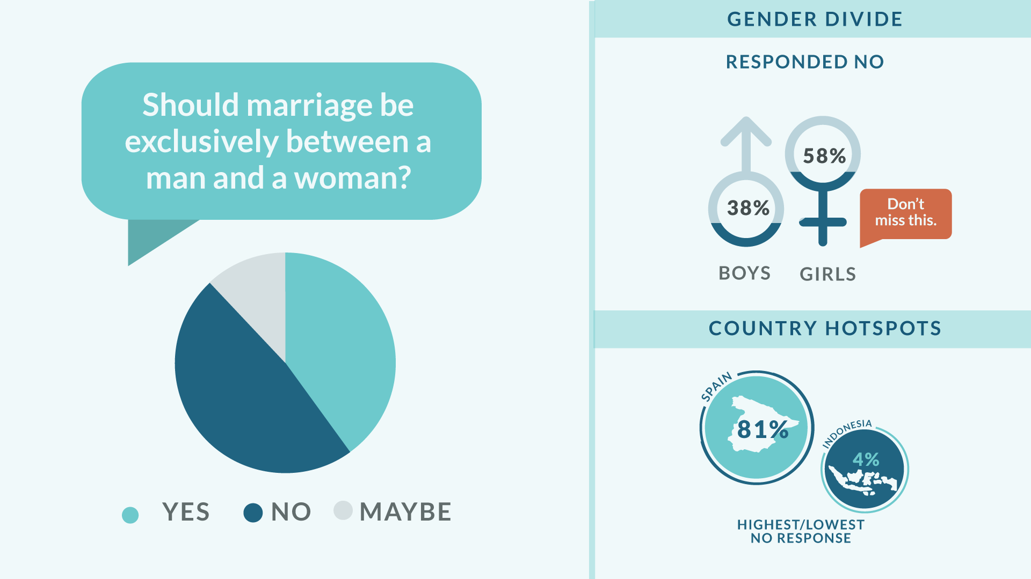

Slide 42


Slide 43


Slide 44
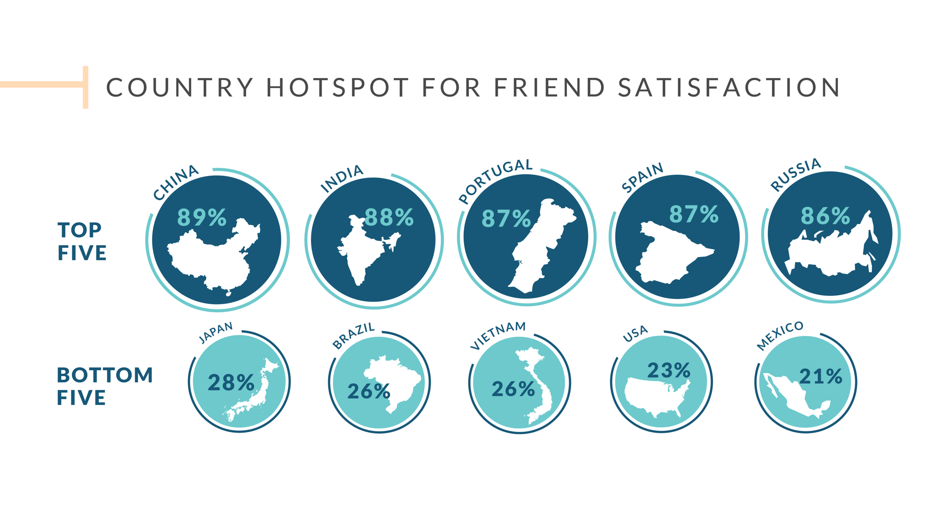

Slide 45


Slide 46


Slide 47


Slide 48


Slide 49


Slide 50


Slide 51


Slide 52


Slide 54
ADDITIONAL CUSTOMIZABLE SLIDES

Slide 55

INTERNAL USE ONLY
Internal Use Only

Slide 56































ICON LIBRARY
Copy and paste any of these icons to illustrate specific statistics. The color and size can all be changed.
The color on these icons cannot be changed, but they can be resized.
Internal Use Only

Slide 57

This is a paragraph about the research. This is a paragraph about the research. This is a paragraph about the research. This is a paragraph about the research. This is a paragraph about the research. This is a paragraph about the research.
Insert graphics/icons in the space below or to the right.
Internal Use Only

Slide 58

This is a paragraph about the research. This is a paragraph about the research. This is a paragraph about the research. This is a paragraph about the research. This is a paragraph about the research. This is a paragraph about the research.
Insert graphics/icons in the space below or to the right.
Internal Use Only

Slide 59

This is a paragraph about the research. This is a paragraph about the research. This is a paragraph about the research. This is a paragraph about the research. This is a paragraph about the research. This is a paragraph about the research.
Insert graphics/icons in the space below or to the right.
Internal Use Only

Slide 60

This is a paragraph about the research. This is a paragraph about the research. This is a paragraph about the research. This is a paragraph about the research. This is a paragraph about the research. This is a paragraph about the research.
Insert graphics/icons in the space below or to the right.
Internal Use Only

Slide 61
This is a paragraph about the research. This is a paragraph about the research. This is a paragraph about the research. This is a paragraph about the research. This is a paragraph about the research. This is a paragraph about the research.
Insert graphics/icons in the space below or to the right.
Internal Use Only

Slide 62
This is a paragraph about the research. This is a paragraph about the research. This is a paragraph about the research. This is a paragraph about the research. This is a paragraph about the research. This is a paragraph about the research.
Insert graphics/icons in the space below or to the right.
Internal Use Only

Slide 63
This is a paragraph about the research. This is a paragraph about the research. This is a paragraph about the research. This is a paragraph about the research. This is a paragraph about the research. This is a paragraph about the research.
Insert graphics/icons in the space below or to the right.
Internal Use Only

Slide 64
This is a paragraph about the research. This is a paragraph about the research. This is a paragraph about the research. This is a paragraph about the research. This is a paragraph about the research. This is a paragraph about the research.
Insert graphics/icons in the space below or to the right.
Internal Use Only

Slide 65
This is a paragraph about the research. This is a paragraph about the research. This is a paragraph about the research.
Insert graphics/icons in the space below or to. the left.
Internal Use Only

Slide 66
This is a paragraph about the research. This is a paragraph about the research. This is a paragraph about the research.
Insert graphics/icons in the space below or to. the left.
Internal Use Only

Slide 67
This is a paragraph about the research. This is a paragraph about the research. This is a paragraph about the research.
Insert graphics/icons in the space below or to. the left.
Internal Use Only

Slide 68
This is a paragraph about the research. This is a paragraph about the research. This is a paragraph about the research.
Insert graphics/icons in the space below or to. the left.
Internal Use Only

Slide 69
This is a paragraph about the research. This is a paragraph about the research. This is a paragraph about the research.
Insert graphics/icons in the space below or to. the left.
Internal Use Only

Slide 70
This is a paragraph about the research. This is a paragraph about the research. This is a paragraph about the research.
Insert graphics/icons in the space below or to. the left.
Internal Use Only

Slide 71
This is a paragraph about the research. This is a paragraph about the research. This is a paragraph about the research.
Insert graphics/icons in the space below or to. the left.
Internal Use Only

Slide 72
This is copy about a graphic being shown above. This is copy about a graphic being shown above. This is copy about a graphic being shown above.
Internal Use Only

Slide 73
This is copy about a graphic being shown above. This is copy about a graphic being shown above. This is copy about a graphic being shown above.
Internal Use Only

Slide 74
This is copy about a graphic being shown above. This is copy about a graphic being shown above. This is copy about a graphic being shown above.
Internal Use Only

Slide 75
This is copy about a graphic being shown above. This is copy about a graphic being shown above. This is copy about a graphic being shown above.
Internal Use Only

Slide 76
This is copy about a graphic being shown above. This is copy about a graphic being shown above. This is copy about a graphic being shown above.
Internal Use Only

Slide 77
This is copy about a graphic being shown above. This is copy about a graphic being shown above. This is copy about a graphic being shown above.
Internal Use Only

Slide 78
This is copy about a graphic being shown above. This is copy about a graphic being shown above. This is copy about a graphic being shown above.
Internal Use Only

Slide 79
This is copy about a graphic being shown above. This is copy about a graphic being shown above. This is copy about a graphic being shown above.
Internal Use Only

Slide 80

Internal Use Only

Slide 81

Internal Use Only

Slide 82
Internal Use Only

Slide 83


