Slide 1


Slide 2



1 in 6 people on the earth right now are teenagers
Notes:
1 in 6 people on the earth right now are teenagers. We can learn more about them and help them navigate their challenging teenage years. The Global Youth Culture study reveals insights into their views on identity, technology, personal struggles, and religious beliefs.

Slide 3
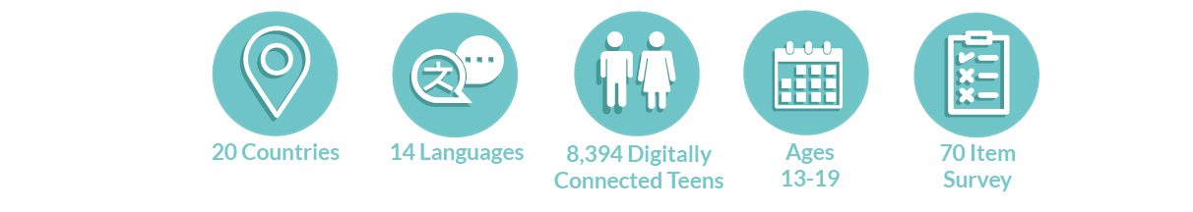
About the Global Youth Culture study
Let’s take a closer look at the responses from U.S. teens…
Notes:
The Global Youth Culture study covers the beliefs and behaviors of more than 8,300 digitally connected teenagers from 20 diverse nations. One of the countries that was included was the United States. Let’s look at the responses from U.S. teens specifically. Keep in mind, that these responses were before COVID-19 restrictions were widely felt.

Slide 4
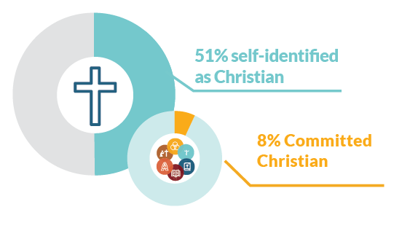
51% of teens surveyed self-identified as Christian.
However, only 8% display the beliefs and habits of a Christian who holds the core beliefs of Christianity and have a regular habit of Bible reading and prayer.
Notes:
A really interesting trend they found was that while teens may call themselves Christians, most of them aren’t actually display the beliefs and actions of a Committed Christian. A respondent would be considered a Committed Christian in this survey if they… Believe God exists and that they can have a personal relationship with Him. Believe Jesus is the Son of God. Believe that forgiveness of sins is only possible through faith in Jesus Christ. Believe the Bible is the Word of God. Read Scripture on their own at least weekly. And pray at least weekly.

Slide 5
2 out of every 5 teens in the U.S. claim no religion
Notes:
We’re seeing a rise the in the number of teens who claim no religion. Sometime they are called the “nones”. This includes atheist and agnostics. Even with this trend though, it looks like they are not necessarily mad at God, actively opposed to Jesus, or skeptical of the Bible’s message. Instead, they mostly say they just don’t think about these things.

Slide 6


However,
Most unchurched teens are open to attending church if someone invited them.
67% said they would be interested in attending or they would consider it.
Notes:
Other good news is that most teens are open to attending church if someone invited them. It doesn’t hurt to ask because 2 out of 3 will at least consider it.

Slide 7
35% of teens in the U.S. reported having suicidal thoughts in the past 3 months.
This is the highest rate in the world across the 20 countries we surveyed.
Notes:
The research revealed that teens are struggling more than we realize. 1 in 3 teens reported having suicidal thoughts in the past three months. Sadly, the U.S. ranked #1 in this compared to the other 19 countries.

Slide 8
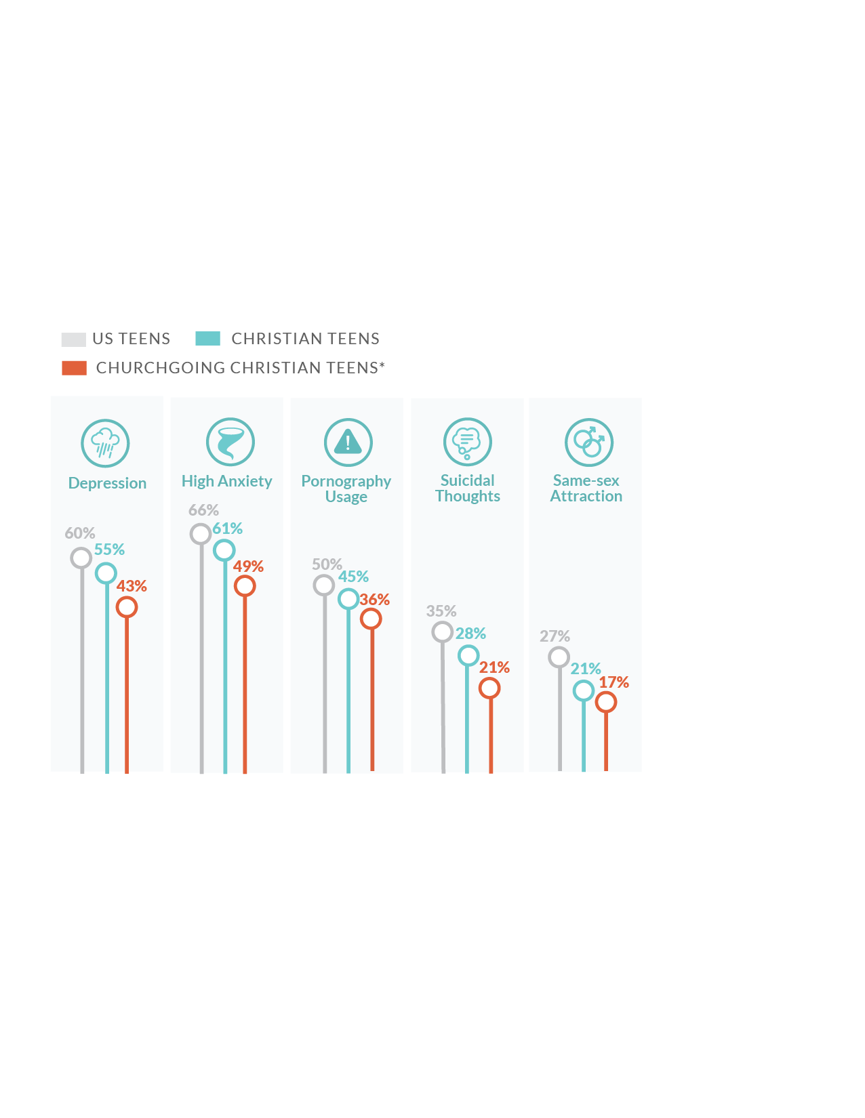
Engaging with a Church community contributes to a more positive outlook on life
In the past three months, I have experienced:
Notes:
But the positive benefits of being engaged with a Church is undeniable. Those teens reported lower rates of at-risk behaviors and concerning mental health issues on nearly every item we measured.

Slide 9
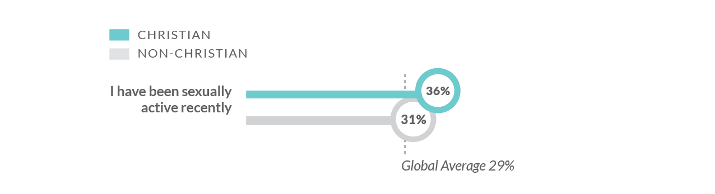
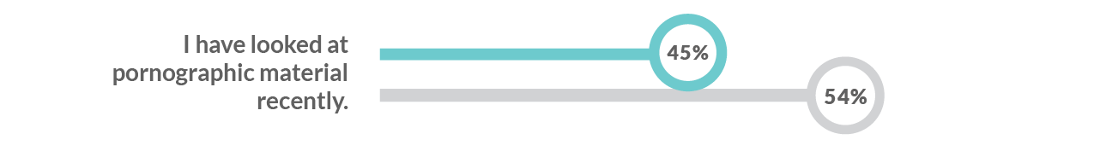
Christian teens are more sexually active than non-Christian teens
Notes:
This was really interesting to find out, and will probably come as a shock to you. Alarmingly, Christian teens are more likely to be sexually active than non-Christians. Many young believers don’t even believe pre-marital sex is wrong. And even those who identify as Christians, 45% say they have looked at porn recently.

Slide 10
96% of teens watch videos everyday.
Notes:
Just one other thing I wanted to point out, 96% of teens are watching videos every day. They are engaged in the digital space. YouTube and apps like Tik Tok are very influential to them. Is there more we could be doing to engage them online?

Slide 11
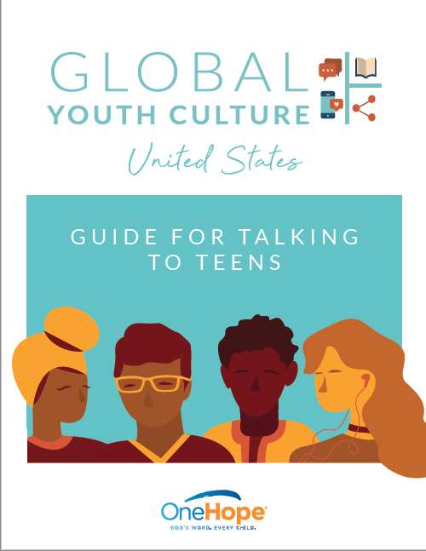


Access our library of resources at GlobalYouthCulture.net
Notes:
This is just a really brief snapshot into the lives of U.S. teens. You can find more resources for parents and pastors online, along with the entire report about all 20 countries. Check it out at globalyouthculture.net It’s all free.

Slide 12


@onehopeministry

