Slide 1


Africa Report

Slide 2

1 in 6 people on the earth right now are teenagers.
Notes:
1 in 6 people on the earth right now are teenagers. We can learn more about them and help them navigate their challenging teenage years. The Global Youth Culture study reveals insights into their views on identity, technology, personal struggles, and religious beliefs.

Slide 3

ABOUT THE GLOBAL YOUTH CULTURE STUDY
20 Countries
14
Languages
8,394 Digitally Connected Teens
Ages
13-19
70 Item Survey
Let’s take a closer look at the responses from African teens…
Notes:
The Global Youth Culture study covers the beliefs and behaviors of more than 8,300 digitally connected teenagers from 20 diverse nations. Three countries included were from Africa (Kenya, Nigeria, and South Africa). Let’s look at the responses from U.S. teens specifically. Keep in mind, that these responses were before COVID-19 restrictions were widely felt.

Slide 4

ABOUT THE TEENS
78% of African teens identified as Christian—the highest of any region in our global study
However, only 28% display the beliefs and habits of a Christian who holds the core beliefs of Christianity and have a regular habit of Bible reading and prayer.
Notes:
Globally, only 7% of teens surveyed were Committed Christians. In Africa, however, we discovered that 28% of teens were Committed Christians. Nigeria, Kenya, and South Africa were the top 3 countries globally to have the most Committed Christian young people. A respondent would be considered a Committed Christian in this survey if they… Believe God exists and that they can have a personal relationship with Him. Believe Jesus is the Son of God. Believe that forgiveness of sins is only possible through faith in Jesus Christ. Believe the Bible is the Word of God. Read Scripture on their own at least weekly. And pray at least weekly.

Slide 5

6 TRAITS OF COMMITTED CHRISTIANS
Believe Jesus is the Son of God
Believe God exists and they can have a personal relationship with Him
Believe that forgiveness of sins is only possible through faith in Jesus Christ
Pray at least weekly
Believe the Bible is the Word of God
Read Scripture on their own at least weekly
Note that these teens self-identified as Christian, but not as Jehovah’s Witness or Mormon. Committed Christians may be Catholic, Seventh Day Adventist, Orthodox, or a number of other denominations.

Slide 6

WEEKLY HABITS OF CHRISTIAN TEENS IN AFRICA
80% spend time in prayer
60% attend religious services
45% read their Bible
Notes:
Engaging in spiritual disciplines is how we grow our faith. Encouragingly, Christian teens in Africa reported praying and attending church regularly. However, fewer than half are reading their Bibles at least weekly. In contrast, Muslim teens in Africa are seen to be quite disciplined about reading their religious scripture and similarly devout as Christians in praying and attending religious services. Teens of other beliefs said they sometimes engage in these religious behaviors.

Slide 7

8 in 10 teens in Africa say
their family experience has been good.

Slide 8
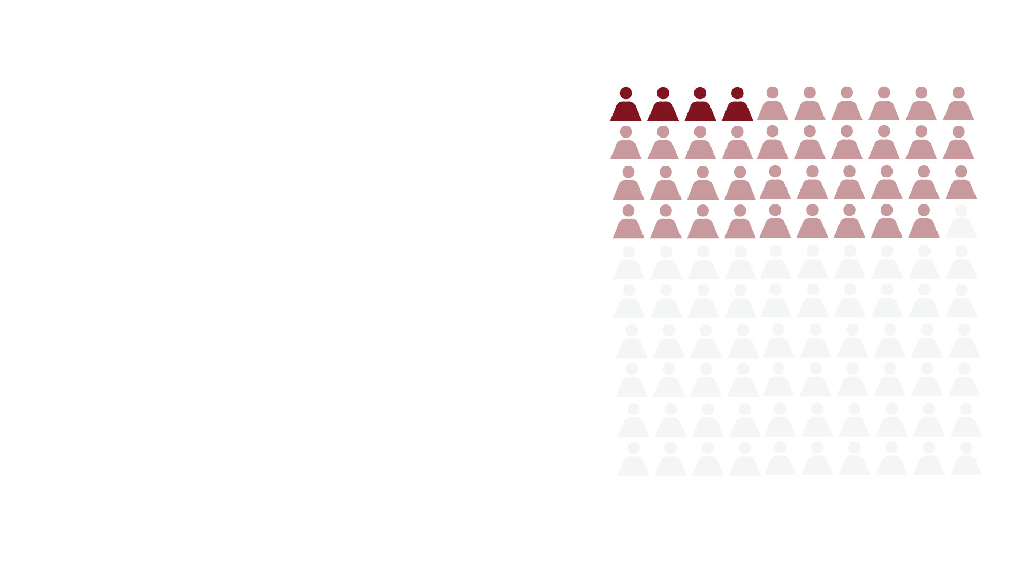
1 in 4 teens in Africa (24%) report having had suicidal thoughts within the last three months.
4% of teens reported that they actually attempted to take their own life.

Slide 9
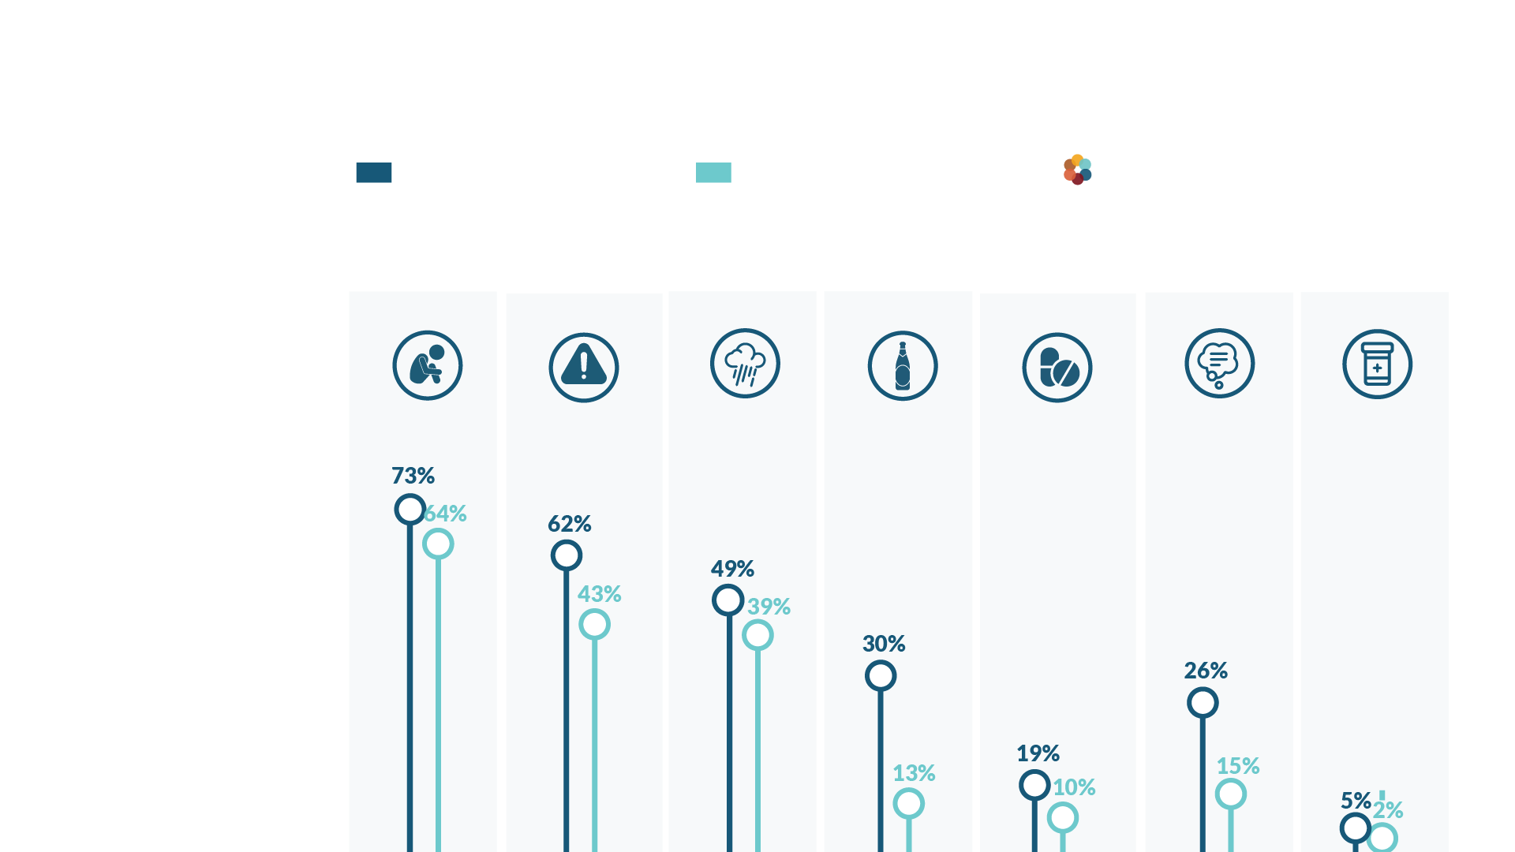
NOMINAL VS. COMMITTED CHRISTIAN STRUGGLES
NOMINAL CHRISTIAN
COMMITTED CHRISTIAN
Within the past three months, I have experienced:
Positive benefits of being a Committed Christian
Loneliness
Viewed
Pornography
Depression
Been Drunk
Used Drugs
Suicidal Thoughts
Suicide Attempts
Notes:
Positive benefits of being a Committed Christian
The positive benefits of being a Committed Christian are undeniable. Committed Christians reported lower rates of at-risk behaviors and concerning mental health issues on nearly every item we measured.

Slide 10

72% of teens in Africa believe gender is primarily based on the sex a person is born as.
Almost 1 in 5 teens in Africa report having felt sexually attracted to someone of the same gender within the past three months.
Notes:
Some teens are struggling more with same-sex attraction than others. For example, teen girls are twice as likely to report this than teen boys. Teens of other religions or no religion are much more likely than Christians or Muslims to be facing this. Among Christian teens, Committed Christians were less likely than Nominal Christians to say this is a current struggle for them.

Slide 11

of teens say they watch videos every day.
Notes:
Videos are part of every teen’s daily life and can be a powerful vehicle to reach young people. Teens are constantly returning to platforms like YouTube and Netflix and watching video content every day. How can we use this appealing medium to reach young people for Christ?

Slide 12

Access our library of resources at GlobalYouthCulture.net
Notes:
This is just a really brief snapshot into the lives of African teens. You can find more resources for parents and pastors online, along with the entire report about all 20 countries. Check it out at globalyouthculture.net It’s all free.

Slide 13



